Slide 1

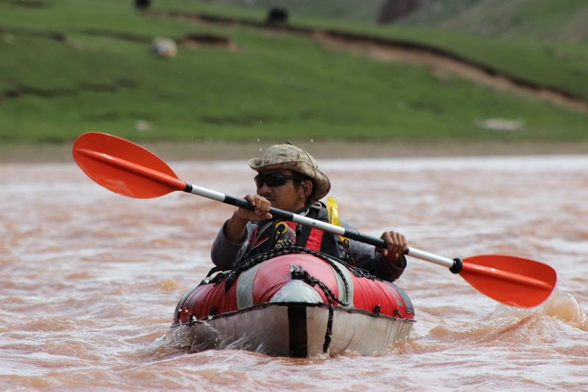
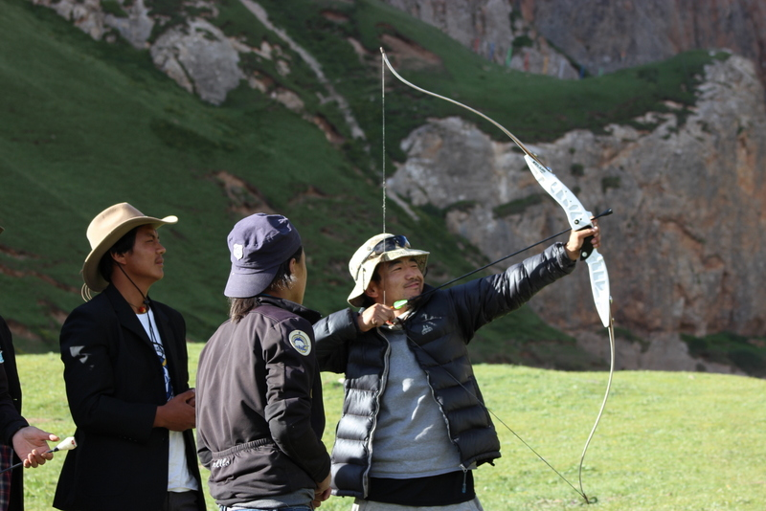
Suojia Community Ecotourism Plan
Development for Protection

Slide 2
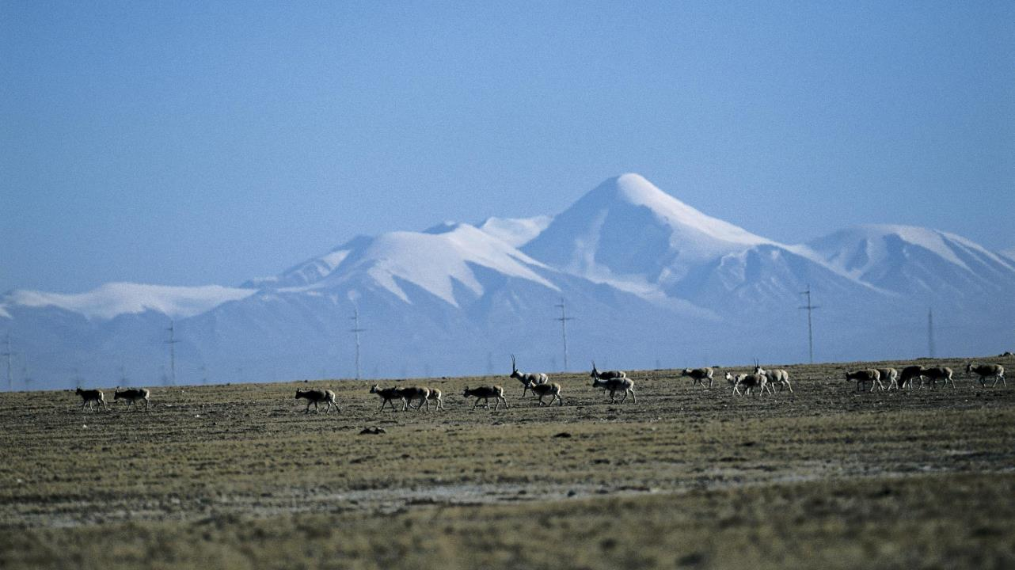
Introduction
【What is Eco-tourism?】
Suojia village is located in the hinterland of the Qinghai-Tibet plateau, with an average altitude of 4700 meters
Suojia village is located in the Sanjiangyuan region, rich in flora and fauna
Main wildlife includes Tibetan antelope (chiru), snow leopard, Tibetan wild ass (kiang), argali, Tibetan gazelle, more than 60 species of birds including black-necked cranes
The local community benefits from protection, with outcomes in both conservation and development

Slide 3
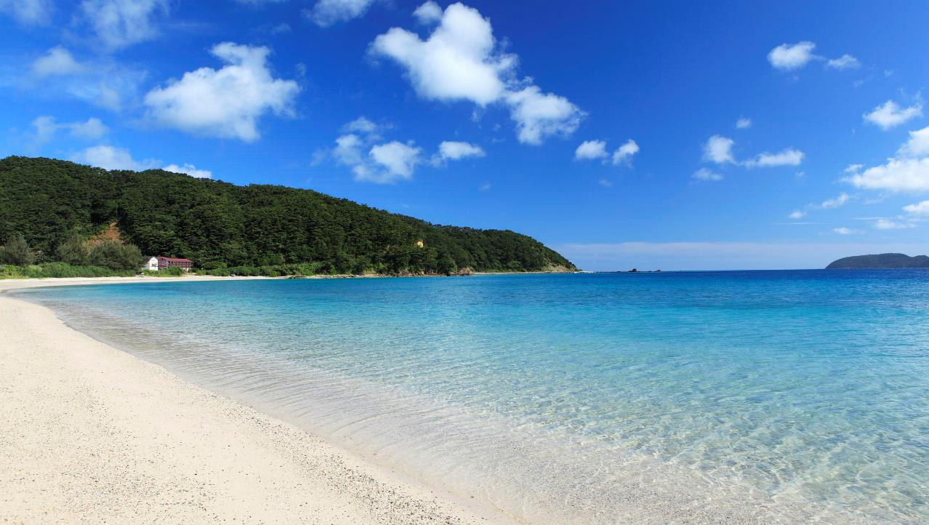
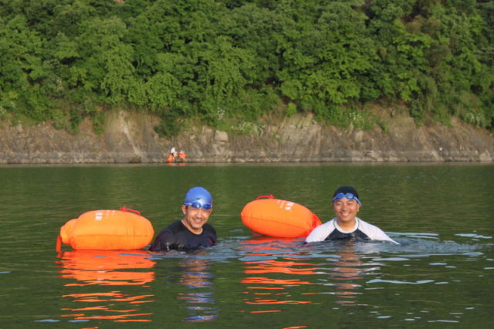
Background
Since January 2014, we brought Tibetan teams to Jiangsu and Zhejiang provinces and to Beihai in Guangxi for training in water sports. On the one hand, it is warmer in winter, when little can be done on the plateau. Additionally, sea training can greatly help to alleviate a fear of water.

Slide 4

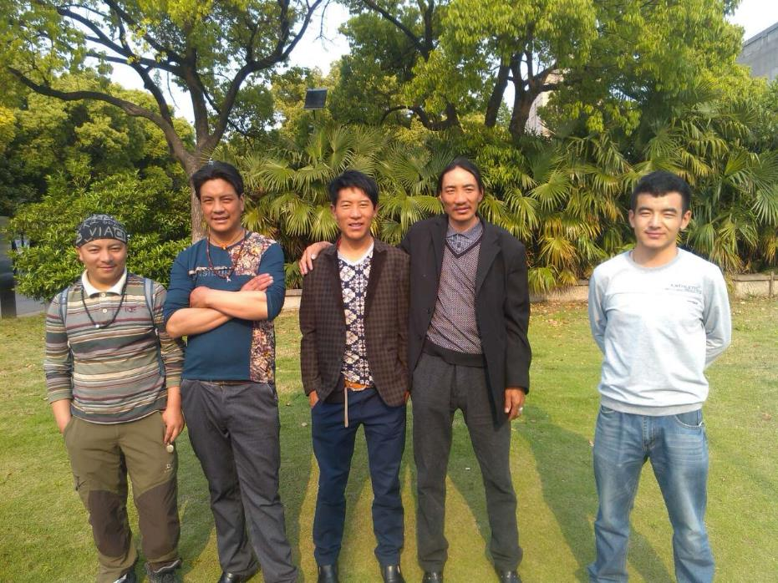
Background
Duojie, Gaduojie,
Gongjia, Luosang.
When they just arrived in Shanghai.

Slide 5
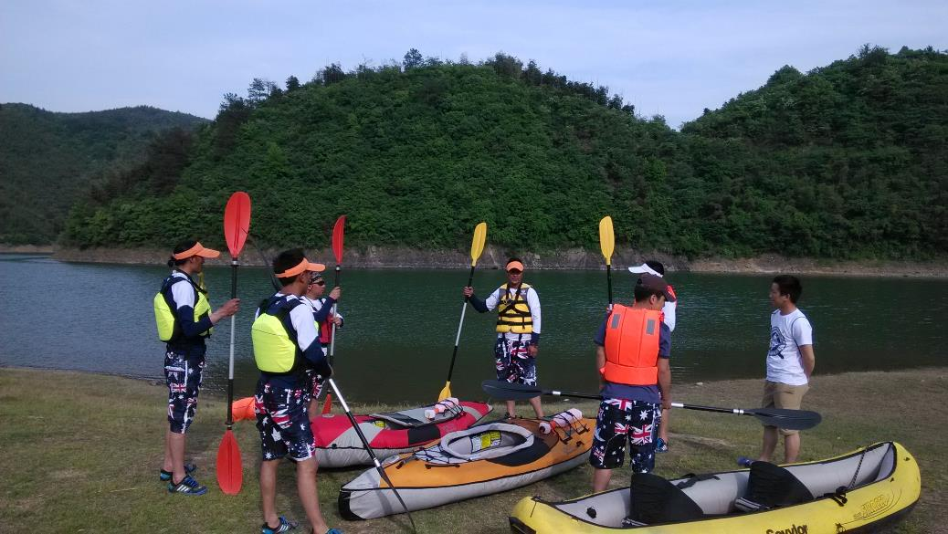
Background
After a week in Shanghai, the trainees headed for Zhejiang where they began their training.

Slide 6
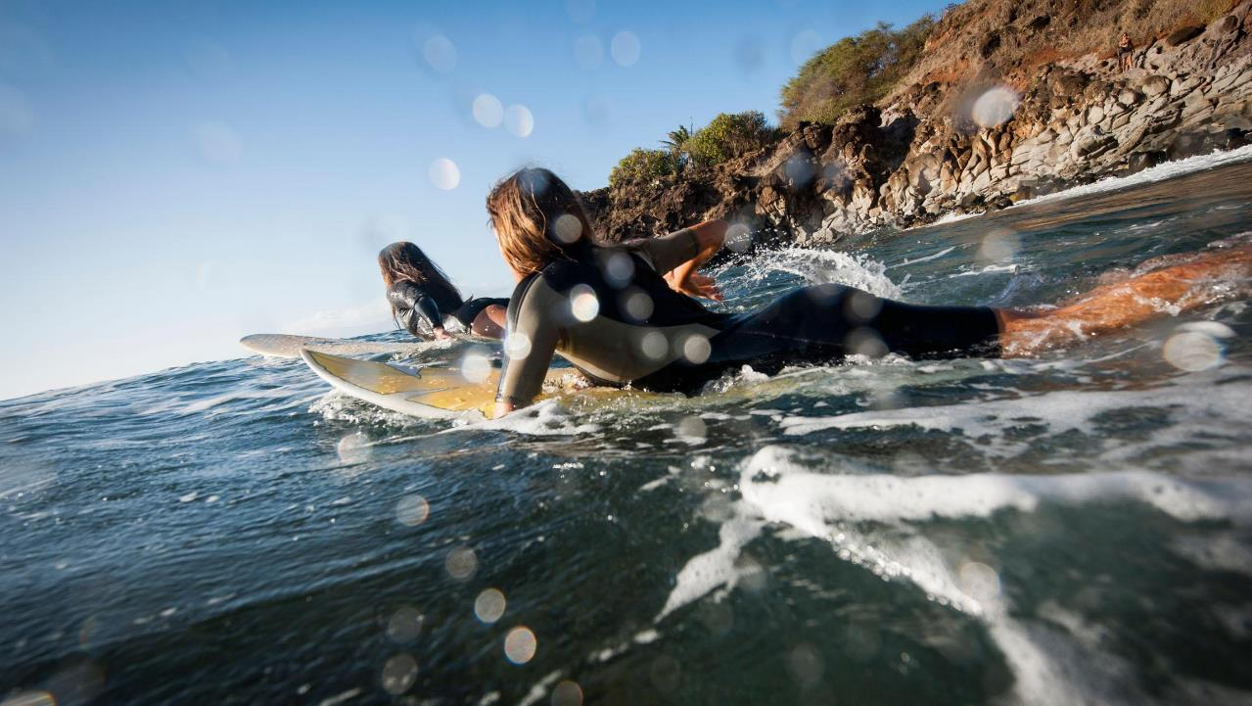
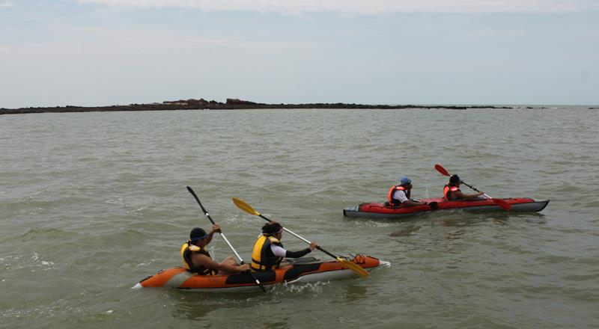
Members
【Last two weeks at Beihai for marine boat training】

Slide 7
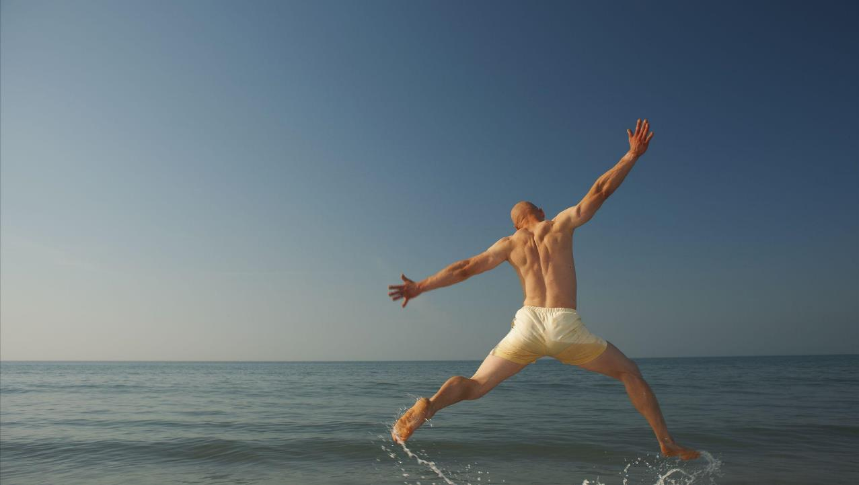
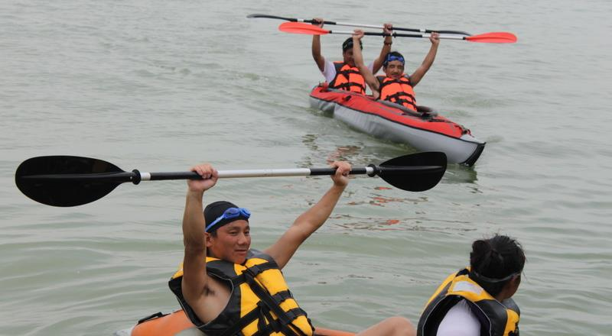
Everyone successfully finished their training and graduated.

Slide 8
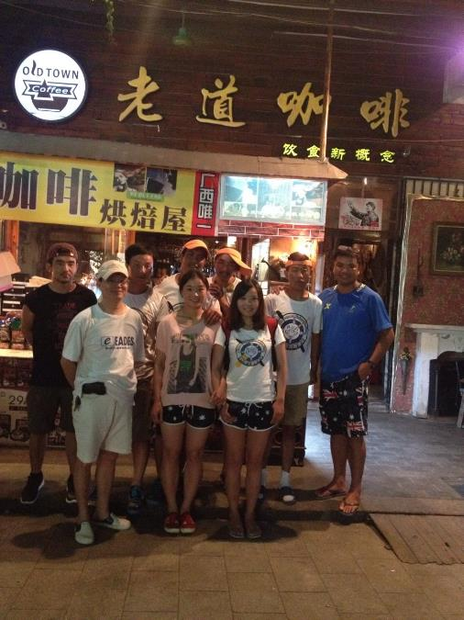
Background
Regular contact with local tourism operators also helped improve their intuitive understanding of ecotourism…
Additionally…

Slide 9
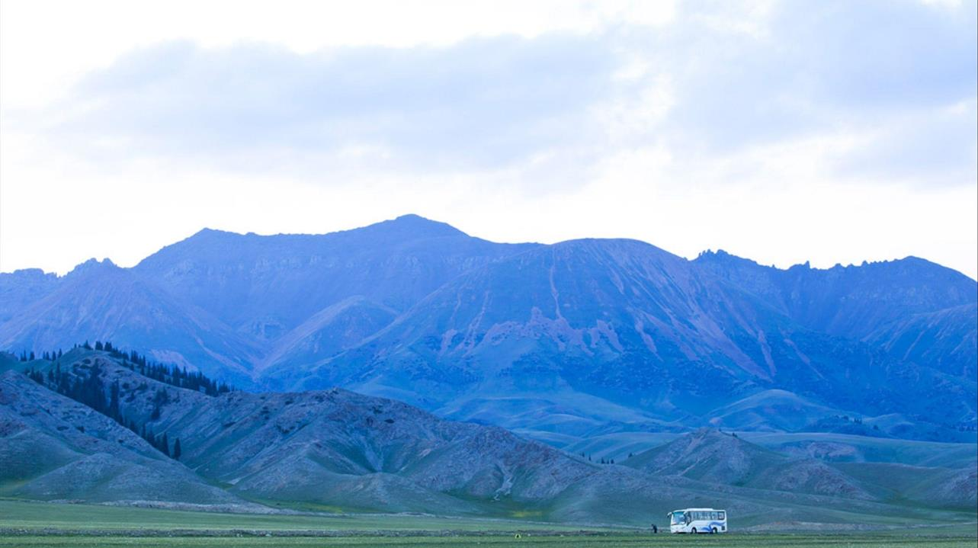
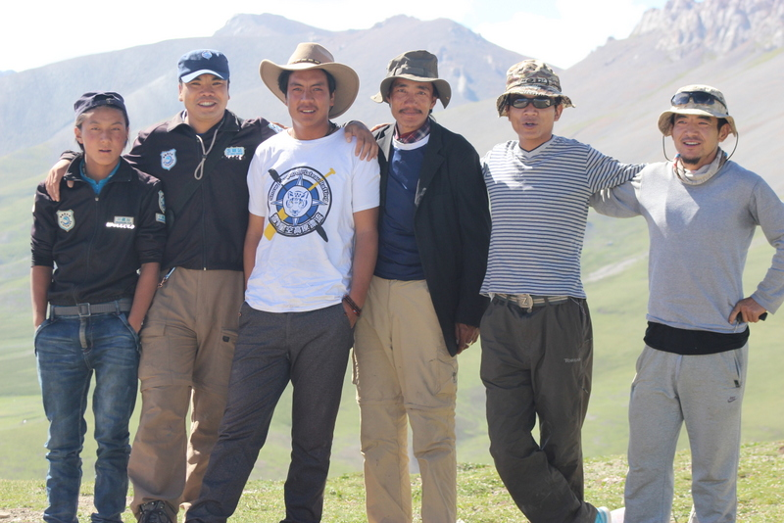
Members
In July, they were trained in Suojia village and became rafting guides.

Slide 10
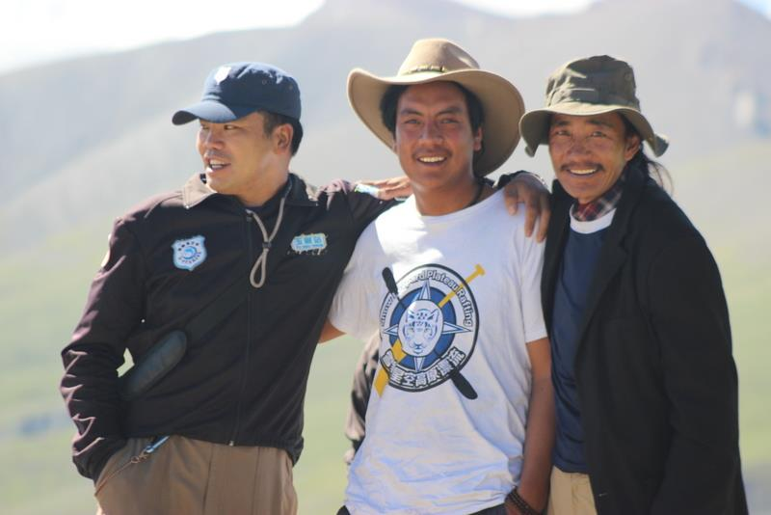
Now they are more confident working in their hometown.

Slide 11
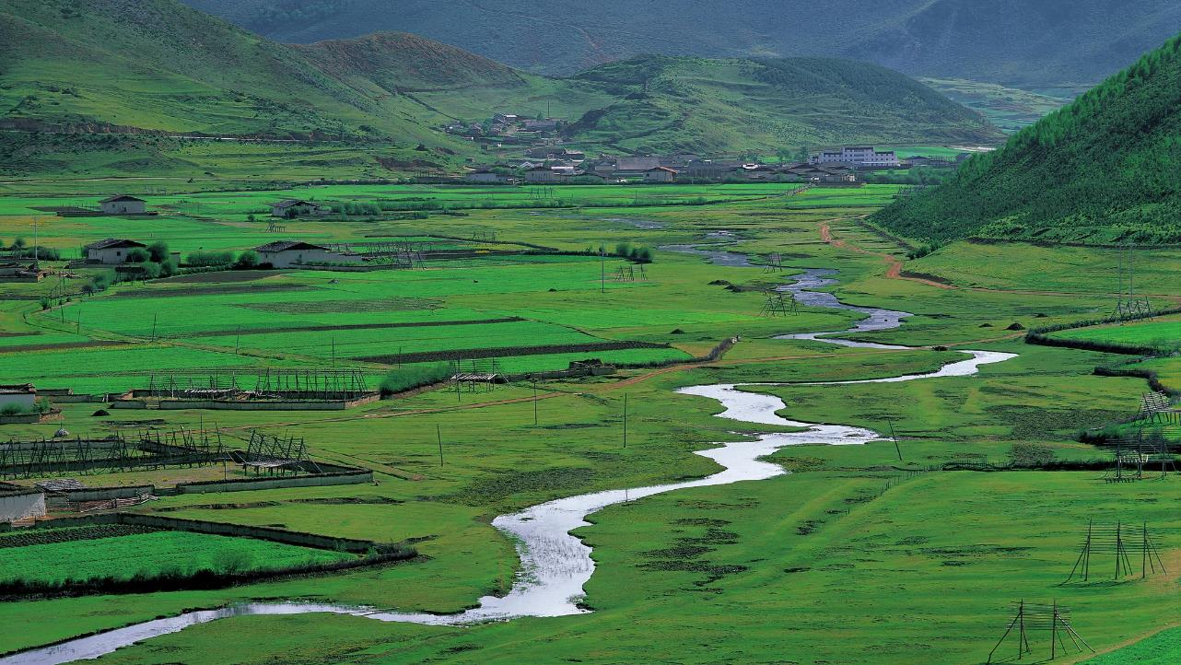
Suojia
Ecotourism
Project
Background

Slide 12
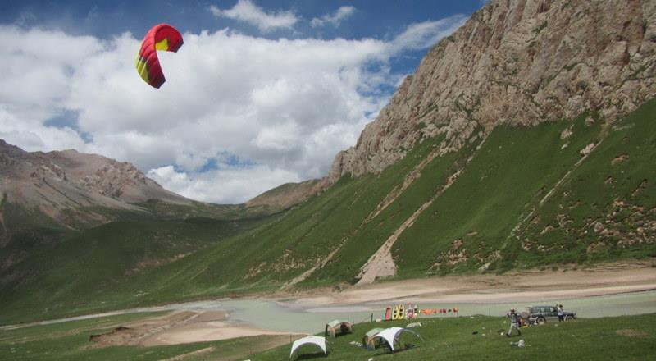
Building the Suojia rafting base camp

Slide 13
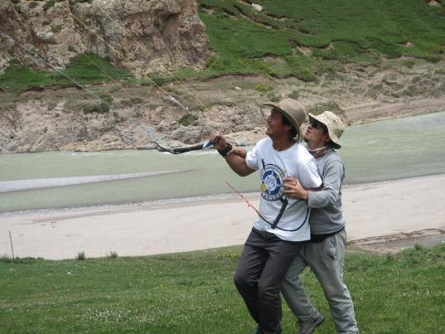
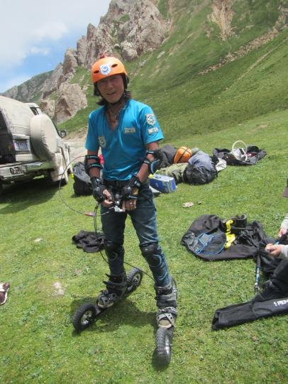
Rafting camp activities
Paraglider kites and archery are exciting activities

Slide 14
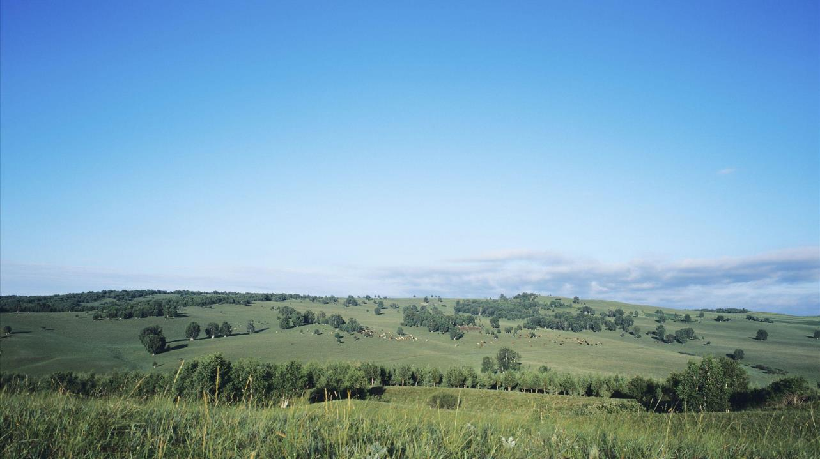
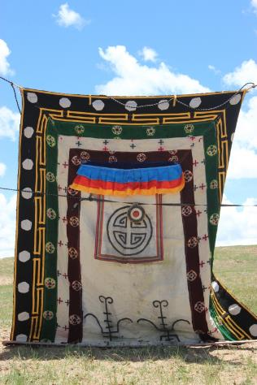
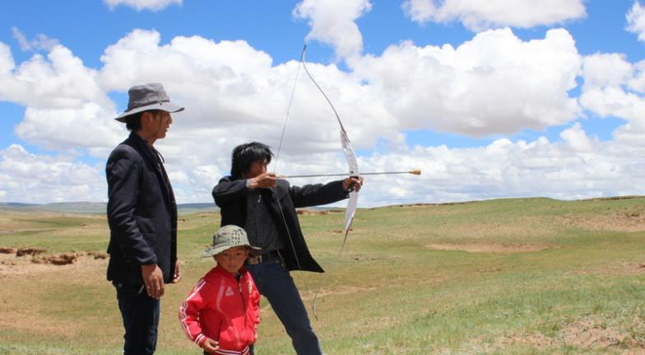
Traditional archery

Slide 15
Plateau rafting exploration at 4700 meters above sea level

Slide 16
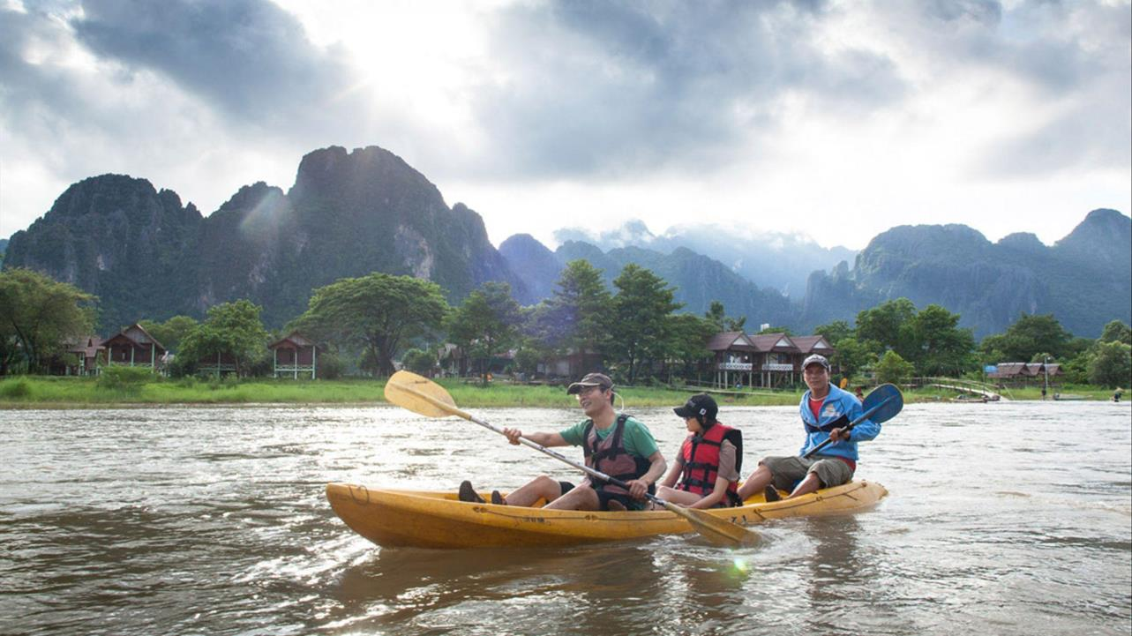
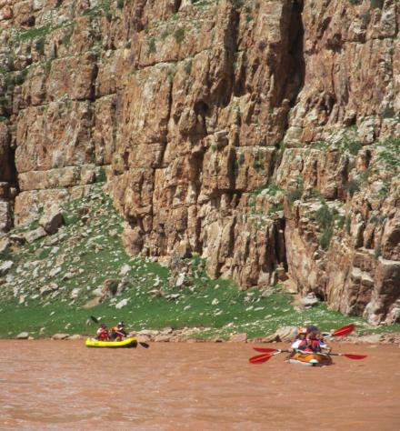
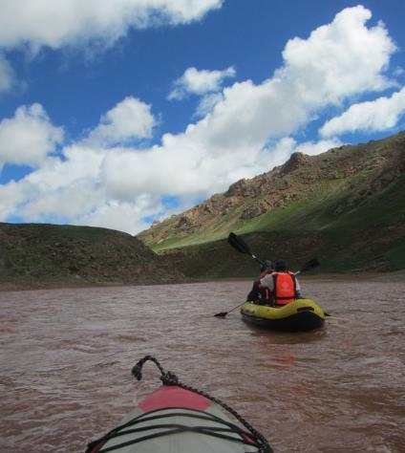
Rafting Exploration
The rafting takes an hour and half, and there are many lunch spots along the way…

Slide 17
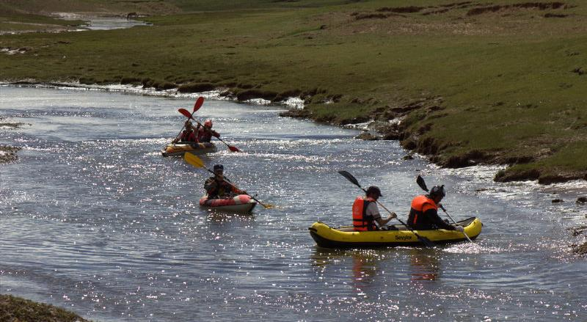
Rafting Exploration
Finally, the ~8 km rafting descent finishes at the Suojia village school

Slide 18
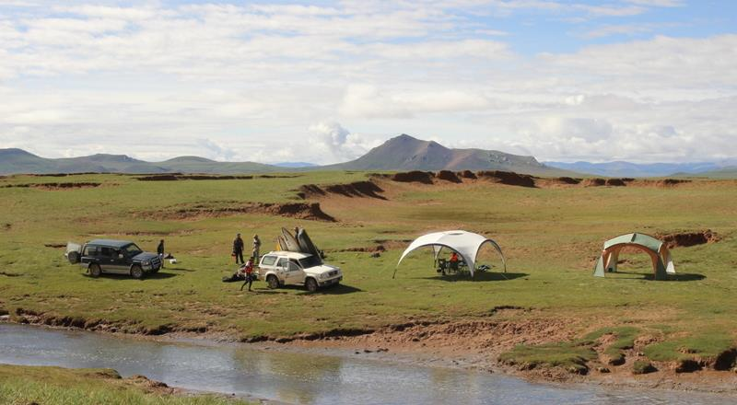
Considering Suojia’s four main wildlife habitats (for snow leopard, brown bear, Tibetan wild ass, and blue sheep), we can design wildlife-watching rafting trips along four corridors on a range of small rivers – the basis of Suojia ecotourism.

Slide 19
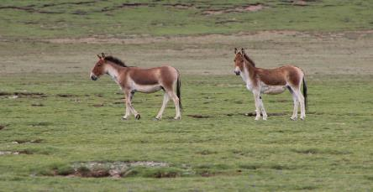
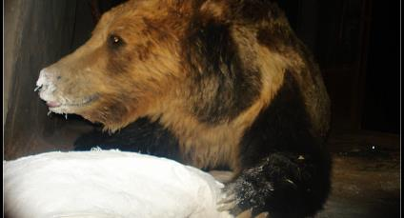
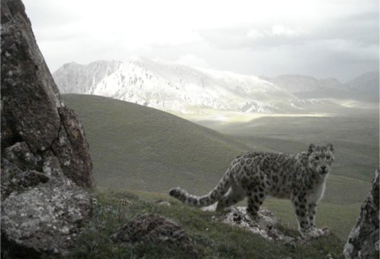
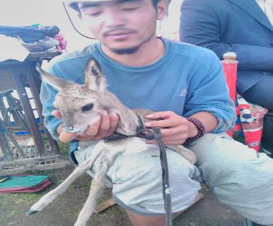
Four corridors for wildlife observation rafting
Tibetan wild ass
Brown bears
Blue sheep
Snow leopards

Slide 20
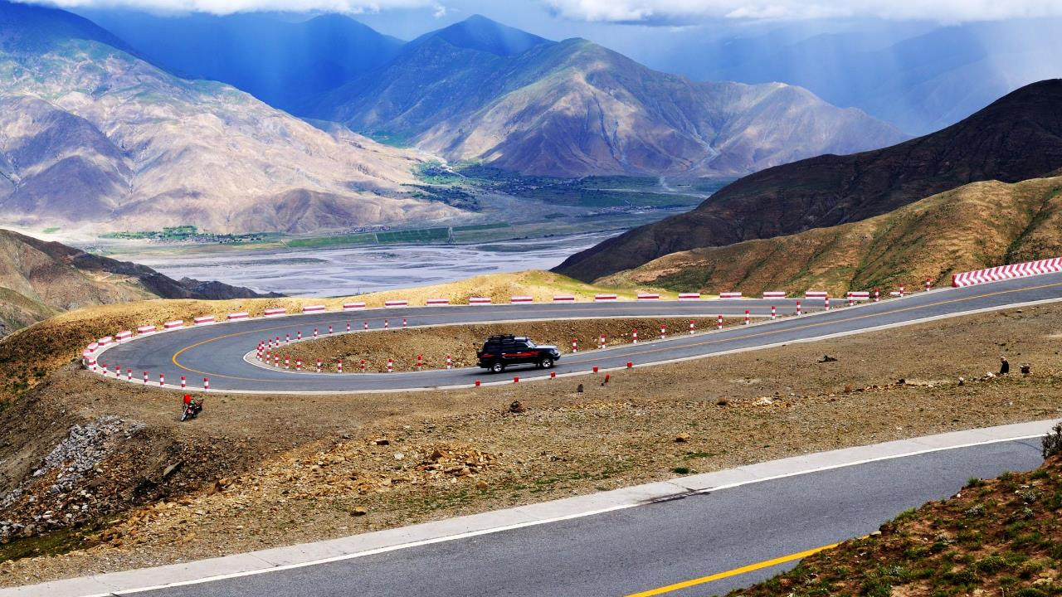
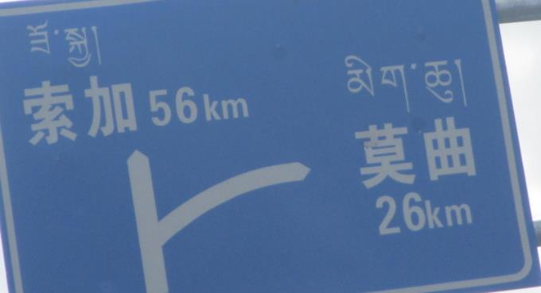
Challenges
Long journey, no reception facilities, difficult access with limited contact to the outside world

Slide 21
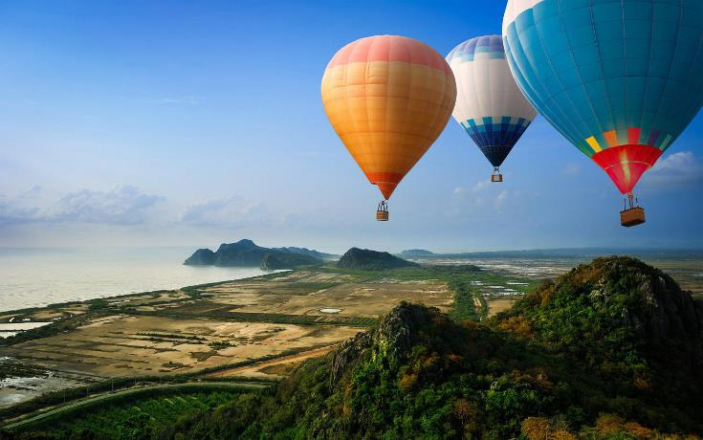
Future Plans
Suojia could become a high-end international ecotourism area.

Slide 22
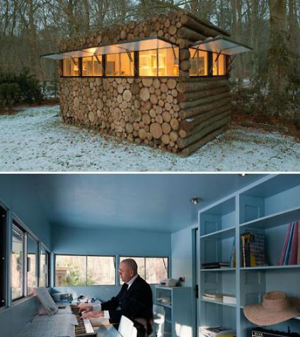
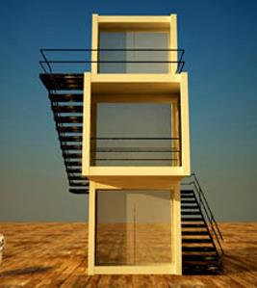
Solutions? maybe could use container houses…
Four advantages of container houses:
Eco-friendly
Mobile
Healthy and comfortable
Can prevent bear attacks

Slide 23
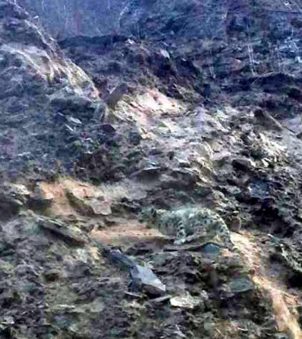
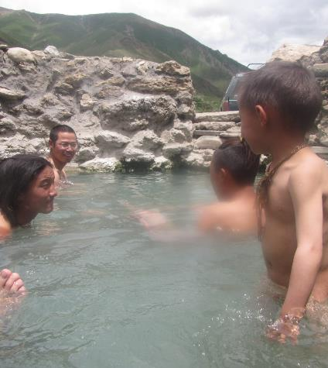
Much good potential
In addition to Suojia, Longbao near Yushu also is rich in wildlife, special habitats, and ecotourism resources

Slide 24
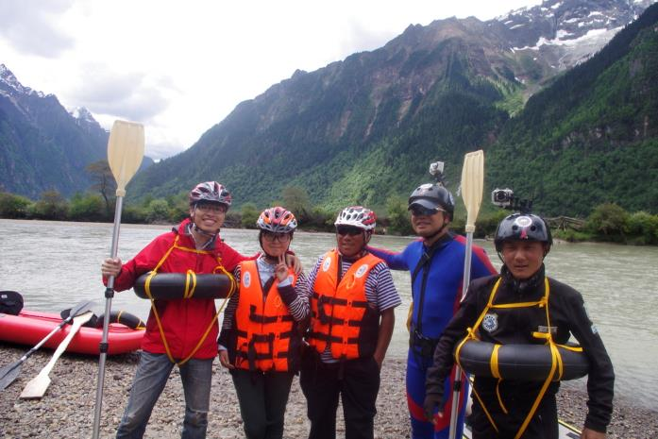
The End
The End
The Beginning!

